Slide 1

SAP BTP ABAP on Cloud / RAP Training
DAY-14
Anubhav Oberoy
www.AnubhavTrainings.com
Follow excellence with sheer passion

Slide 2


DISCLAIMER
The training content and delivery of this presentation is confidential, and cannot be recorded, or copied and distributed to any third party, without the written consent of Anubhav Trainings

Slide 3

01
Custom Entity
Service consumption model
02
03
Access External API
04
Consume API
Notes:
https://pixabay.com/photos/san-francisco-transamerica-pyramid-1633203/

Slide 4
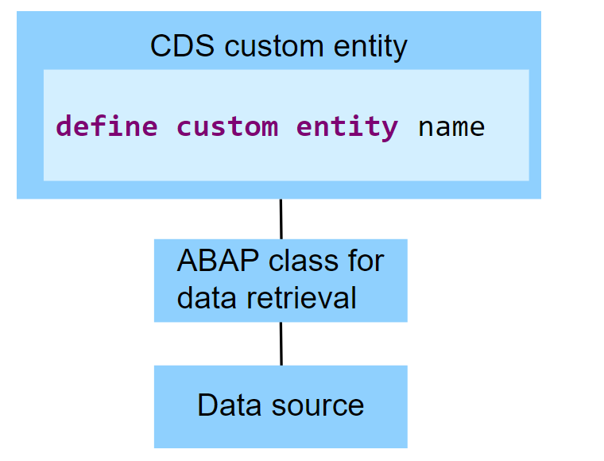
Custom Entities
A CDS custom entity allows developers to implement their own data retrieval using ABAP. A CDS custom entity is linked with an ABAP class and the data retrieval is executed on the application server. At the CDS level, only an interface is defined. Custom entities are used when data can't be accessed using SQL and the available CDS feature set.
The following image exemplifies the runtime of a CDS custom entity. It shows that the data retrieval is implemented by an ABAP class and the data source does not have to be a database table.
www.anubhavtrainings.com

Slide 5
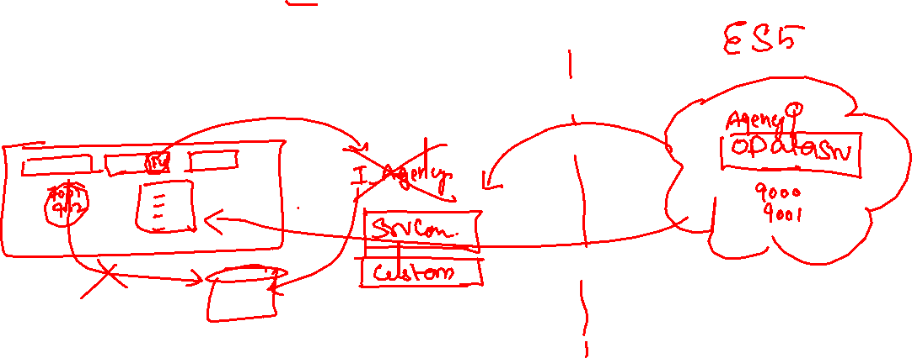
Reference Scenario – Custom Entity
In this exercise, we want to replace the travel agencies data of our managed travel app with the results of the remote OData service that provides different set of travel agencies from other system altogether. For this use case, we shall leverage the concept of a custom entity. In contrast to "normal" CDS views that read data from the database tables or other CDS views, the so-called custom entities act as a wrapper for a code-based implementation that provides the data instead. This use case involves following steps.
Creating the Service Consumption Model
Defining the Custom CDS Entity
Create a class that implements the query for the custom entity
Integrate the custom entity in MDE
www.anubhavtrainings.com

Slide 6










Slide 7
Reference Scenario – Unmanaged Impl.
Imagine in our company we had written all the business logic in the past ourself in form of FM, Classes. Today we want to reuse our old code which has the business logic, validation, sequence, processing, along with transaction buffer. So if you want to manage all these codes yourself and integrate your legacy (old code written by you or your team), you will opt for unmanaged (here RAP is not managing the CURD operation) scenario.
SAP is providing a demo class for learning purpose viz. /dmo/cl_flight_legacy
In this class we have our own old logic which contains the transaction buffer and business logic to maintain all the source code to interact with database ourself.
The RAP framework allows us to implement the entire runtime of the BO
Interaction Phase (code to interact and keep data inside itab)
Transaction Buffer (like a internal table where we keep temporary data)
Save Sequence (Commit work and Rollback)
UPDATE_BAPI
(LUW)
BAPI_TR_COMMIT
BAPI_TR_ROLLBACK
www.anubhavtrainings.com

Slide 8
Development Flow
Serv Impl.
BIMP-unmanaged
Serv definition
BDEF - unmanaged
Travel_U
Travel_U_MDE
Agency
Customer
agency
customer
/dmo/travel
www.anubhavtrainings.com

Slide 9
Title
<>
How you know in the code which fields are changed on the screen by the user.
So accordingly we can update the data into the database only for the changed fields??
RAP provides a compiler structure called %control which will tell us what fields were changed on UI.
We need to tell the RAP, what will be the datatype for the control structure.
*
*
*
www.anubhavtrainings.com

Slide 10
www.anubhavtrainings.com
Thank You
End of Day 14
www.anubhavtrainings.com

Slide 11


We’re committed to empower you to be
#FutureReady
through powerful training solutions.
We build the workforce of the future.
250+
Corporate Clients
30,000+
Learners Trained
25000+
Learners Placed
FREE WEBINARS
Sign up for free webinars with industry experts every fortnight!
Enroll Now!
Contact us today!
https://anubhavtrainings.com

